Slide 1
DriverPass System Analysis
Daniel Loranger
Notes:
[No speaker notes required for this slide.]

Slide 2
System Requirements
Functional Requirements
The system shall implement user roles within all system and modules, specifically student, teacher, secretary, and administrator.
The system shall implement a Learning Management System Module
Non-Functional Requirements
The system shall be cloud hosted
The system shall run on a Linux server
Notes:
[In your speaker notes, include an explanation of the different requirements you determined for DriverPass’s system. What are the functional requirements you selected to describe? What are the nonfunctional requirements you selected to describe? Be sure to explain how these requirements meet DriverPass’s needs.]
Through the user of user specific roles, the content and administration of various functions can be limited to those individuals that need access to them. For example, a driving teacher would never need access to the students personal information, but a secretary might to update a billing record, or etc. A student likewise should not be able to generate learning materials, or access any of the administrative functions outside of their personal account details. For DriverPass, this helps to ensure that someone cannot accidently access or modify contents they are not authorized to change. This helps to reduce oversight as well as legal risk by restricting information on a need to know basis.
In todays technologies, LMS systems are widely used by academic institutions as well as businesses for providing learning content to their group members. Rather than reinventing the LMS from scratch, it is preferrable to utilize pre-existing LMS modules that are actively used and maintained by outside organizations. For DriverPass, this removes the burden of finding and fixing bugs, as well as keeping up with changes in the security landscape. By using a packaged module, all Driver pass will need to do is apply updates within their own system implementation. This keeps the technical overhead to a minimum allowing better business efficiency.
Having the system be cloud hosted again is targeted at business efficiency as well as conforming to the clients wish to have the system be internet browser based. Through the use of cloud hosting, the server reliability is increased while also removing the upfront costs of buying and deploying a webserver on the physical premises along with hiring and maintaining a server administrator role. All server reliability and hardware expenses are instead shared across all hosting customers and paid via a nominal monthly fee. Additionally, this lends itself well to developing on a browser based UI, as all development work will inherently use the internet at all times which can help to fine tune the operations for varying network conditions not observed in a closed network environment.
By utilizing a Linux server model, the cloud hosting options are maximized while the operational costs are minimized. There are many free Linux operating system options available, and the majority of cloud hosting providers prefer the Linux OS to run on their virtual servers. This benefits DriverPass by reducing operating costs both upfront and in monthly hosting expenses while improving access to growth opportunities via additional distributed servers.

Slide 3
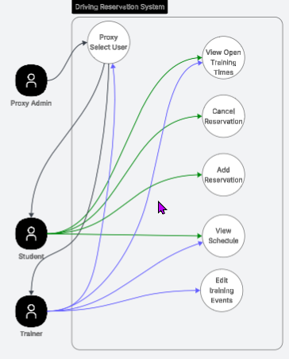
Use Case Diagram
Notes:
[Explain your diagram. Who are the different actors in the system? What are the different use cases? How did you account for DriverPass’s needs in your design? In your explanation, keep your audience in mind. Avoid the use of terms like “actors” and “use cases” in your explanation.]
Through the design activities, the basic needs of each user has been considered, for example, as shown in the representative diagram, we have considered the needs of the student in terms of reserving driving sessions. The student will need the ability to view open time slots, make and cancel their reservations, as well as view their reserved schedule. A driving teacher, likewise needs to be able to view open slots, view their schedule, and make new training slots. Typically they would not need to manipulate a users reservations however. There is an optional hook designed in that will allow proxy admins such as a secretary, admin, or specific trainers, to change their user to a specific student to assist them with their personal reservations. Through the proxy method, all event records will be tracked as the proxy user ensuring full accounting of the transactions are maintained while allowing staff to assist students if required.

Slide 4
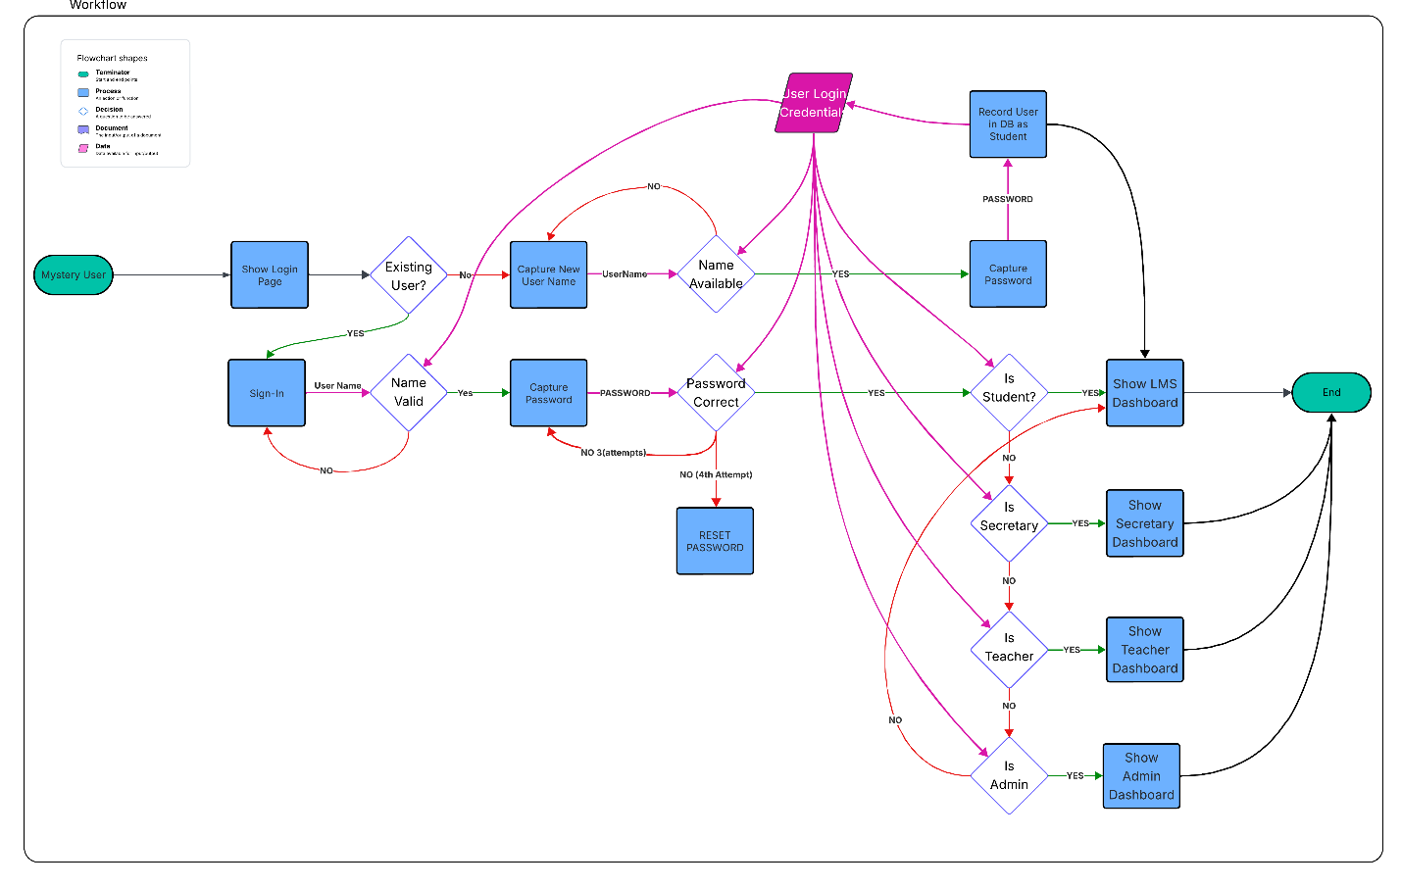
Activity Diagram
Notes:
[Explain your diagram. Which use case are you breaking down? What are the steps for this use case? How did you account for DriverPass’s needs in your design? In your explanation, keep your audience in mind. Avoid the use of technical terms such as “nodes,” “control flows,” and so on.]
When planning the activities, our team identified key workflows and detailed their exact behaviors to ensure the implementation is optimized. This ensures the most intuitive experience while also ensuring that users are only given access to the appropriate content. We have chosen to highlight here a familiar activity that we use every day. The activity of logging into the system as a specific user. You will see in blue boxes specific processes that can break down into more detailed activities such as you see here, but are represented as a single event to help with readability. An example here is to reset a password. This normally requires a specific set of steps, along with security checks, etc., but conceptually, we all understand that and so for this workflow, is just treated as a process event.
In the pink color, is represented the database that holds all user account information that is used in the various processes to authenticate a specific user along with determining their user account access levels.
After the user is logged in, an account type check is administered with appropriate dashboards assigned respectively to optimize their experience. Of note here, is all users when first enrolled are treated as students which has the minimum access levels thus representing the safest registered user type to help prevent mal-actors from accessing more sensitive content. Users may only gain higher privileges thru administrator enacted role upgrades.

Slide 5
Security
Security features implemented
User access control
Transactional based authentication
Transactional based logging
User privilege de-escalation only, no admin overrides allowed
Report generator uses only abstract user identities, no personal identifiable data exported.
….
Notes:
[How did you consider security in your design? In your explanation, keep your audience in mind by avoiding the use of technical terms.]
In all modern systems, security has to be considered one of the highest design priorities. This is required to ensure users trust the systems they work on to be free from intrusion (data safety) as well as be reliable in their everyday usage. Security will trump all other design decisions when considering conflicting inputs.
To help facilitate this level of security, the user interface will utilize several key design choices. First is the user access control; each user is initially a student which has no backend privileges except enrolling in courses and purchasing training credits. From there, it requires an active event by the administrator(s) to upgrade their accounts. In-line with this user access controls, we are implementing a system that only allows de-escalating permissions, so an admin can move down (via proxy user change) to work as a secretary or even as a student to perform various functions, but under no conditions can a student or secretary escalate their privileges to work as an admin. There is strictly forbidden any action that asks for an admin password to perform a specific task or similar that could be utilized to break into an elevated access role.
Additionally, every transaction to the system will be recorded with date, time, user name, user access role, changes, made, etc. that will allow a 100% replayable event tracing log. This is done through a combination of the REST api (a fancy term for network system design information flow) as well as requiring that every network event require the user account credentials to be re-authenticated and checked against their allowed privileges.

Slide 6
System Limitations
ADA compliance for visual impairment will not be supported.
System requires an active internet connection at all times.
Only widely adopted web browsers will be supported, with one primary browser such as chrome or Safari being “officially supported”
Notes:
[What are the limitations of your design? In your explanation, keep your audience in mind by avoiding the use of technical terms.]
ADA compliance is not supported, given the system is meant for users able to operate a motor vehicle which imparts specific visual acuity requirements that would prevent the need for accommodations on this training tool.
Internet connectivity is a must, this is what allows the users to access content, while maintaining the ability to perform logging and enforce security protocols as all times.
There are many browser options on the market for users, and each has their own nuances and limitations. It is not reasonable to support all of them, as such, only the widely used browsers will be considered, with only 1 officially supported for each platform such as windows/android/apple to ensure the best experience while minimizing browser specific behaviors on the code-base.

